Slide 1
MINDLYTICSCARE
PRESENTED BY ALFA ALIAS
S3MCA
PROJECT HEAD :
ASWATHI

Slide 2
ABSTRACT
The project “MindlyticsCare: AI-Powered Psychological Wellness and Behavioral Growth Platform” aims to promote psychological wellness and personal development through an intelligent, user-friendly digital platform. Maintaining emotional well-being and developing healthy habits are essential for a balanced lifestyle. However, individuals may find it difficult to monitor their emotional patterns, maintain consistency in daily habits, and identify suitable strategies for personal growth.
MindlyticsCare introduces an integrated solution that enables users to record daily wellness check-ins, write journal entries, monitor wellness scores, track habits, and participate in 21-day behavioral improvement challenges. The unique feature of the system is its AI-powered wellness analysis, which evaluates user reflections and provides personalized insights, recommendations, hobby-based activities, book suggestions, and conversational wellness guidance.

Slide 3
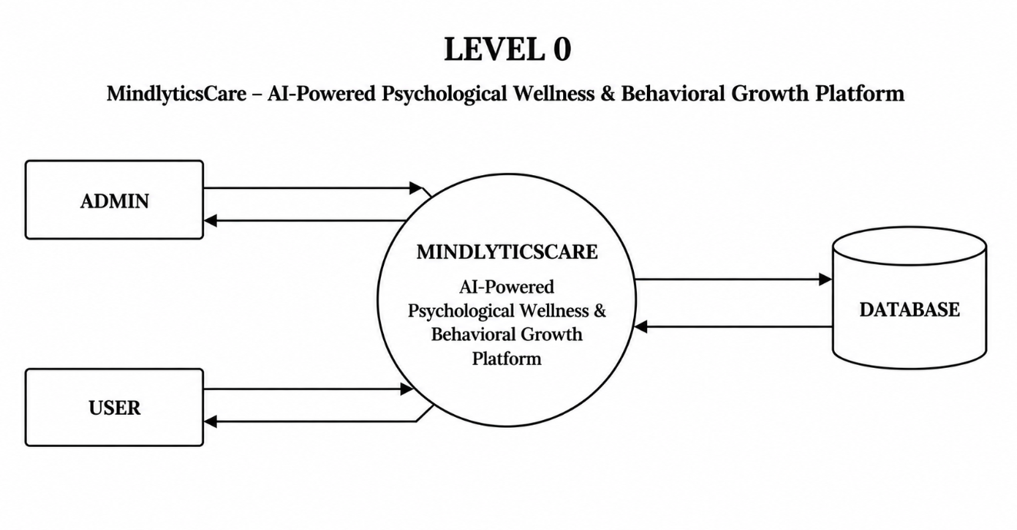
DFD

Slide 4
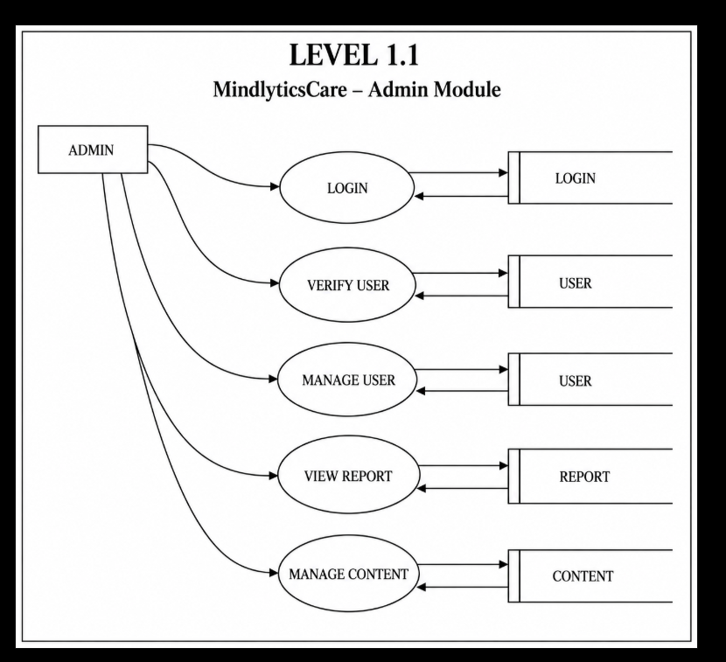

Slide 5
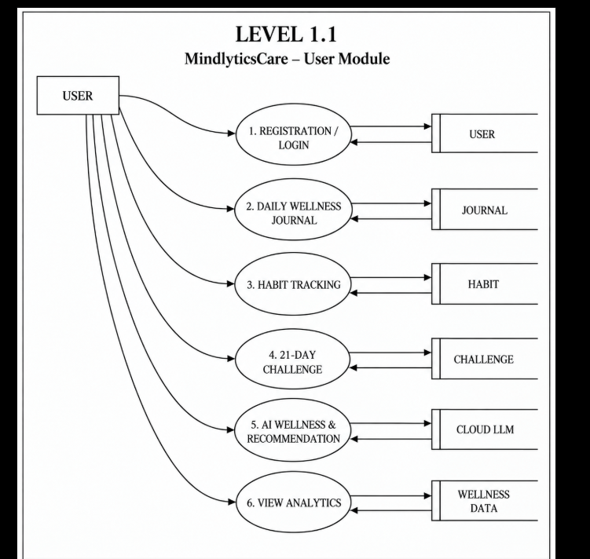

Slide 6
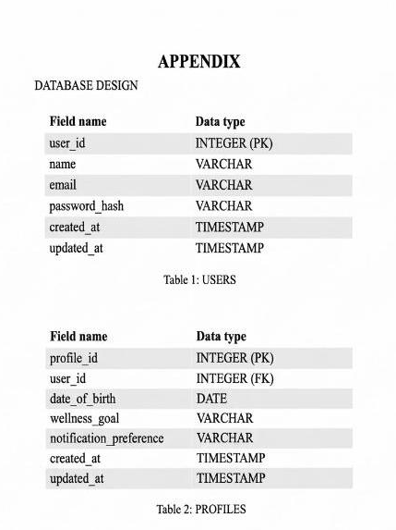
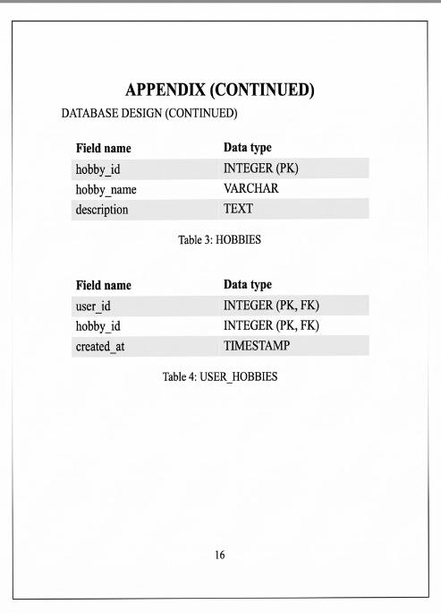
TABLES

Slide 7
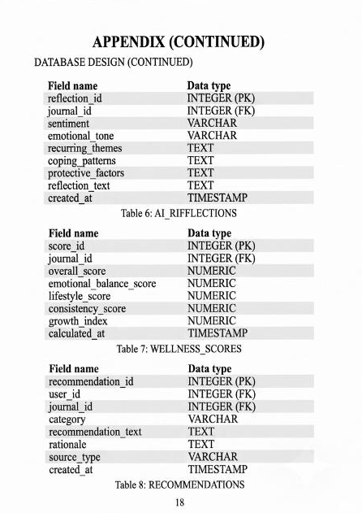
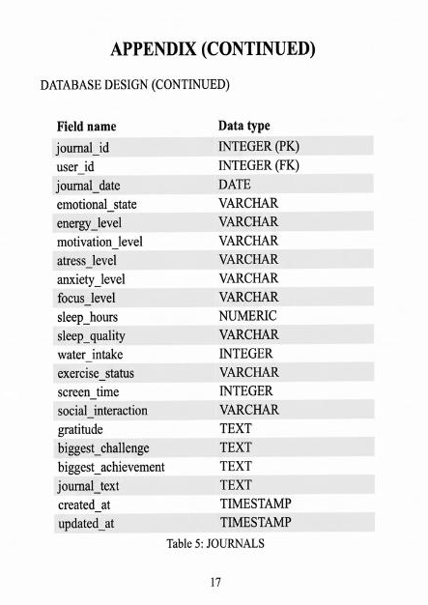

Slide 8
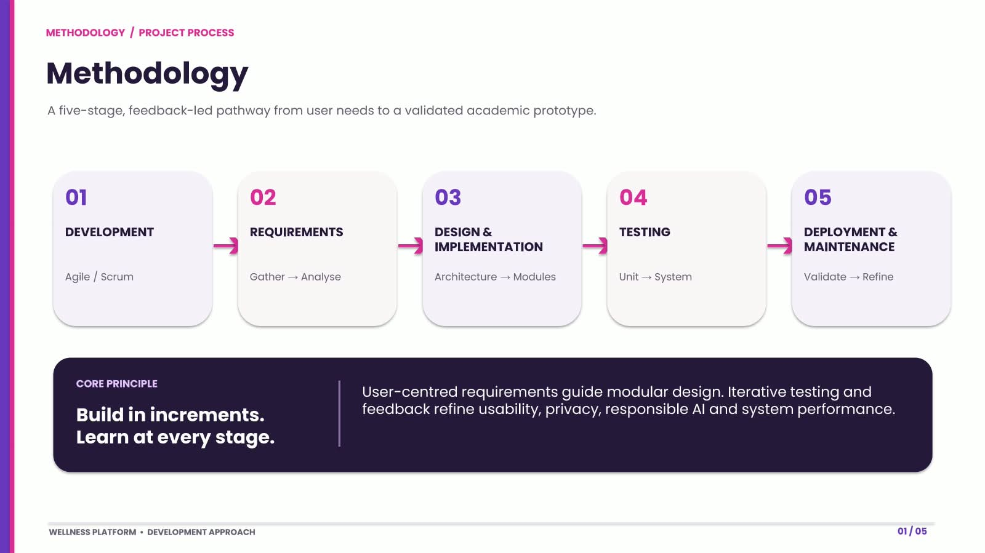
METHEDOLOGY

Slide 9
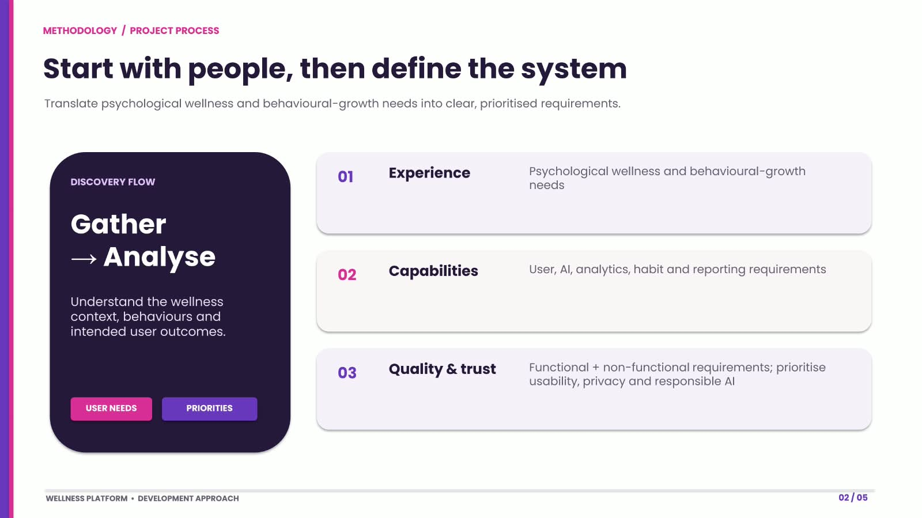

Slide 10
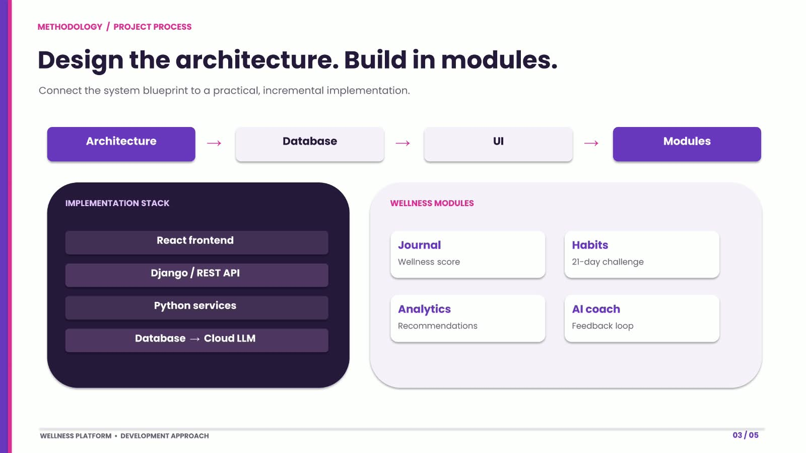

Slide 11
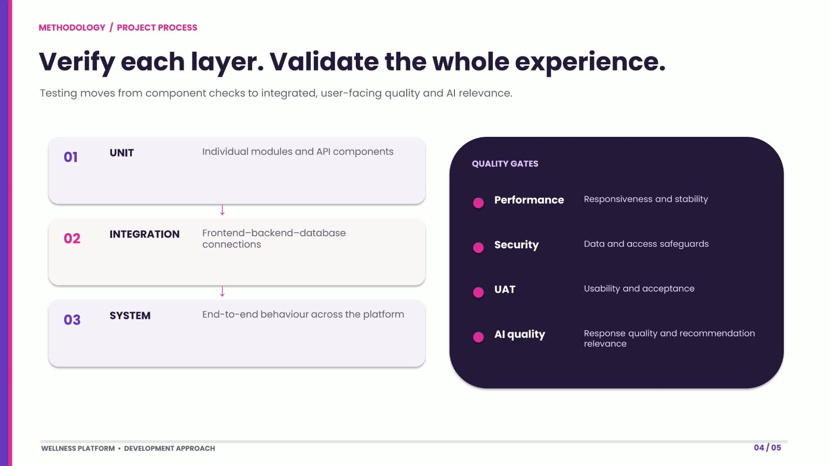

Slide 12
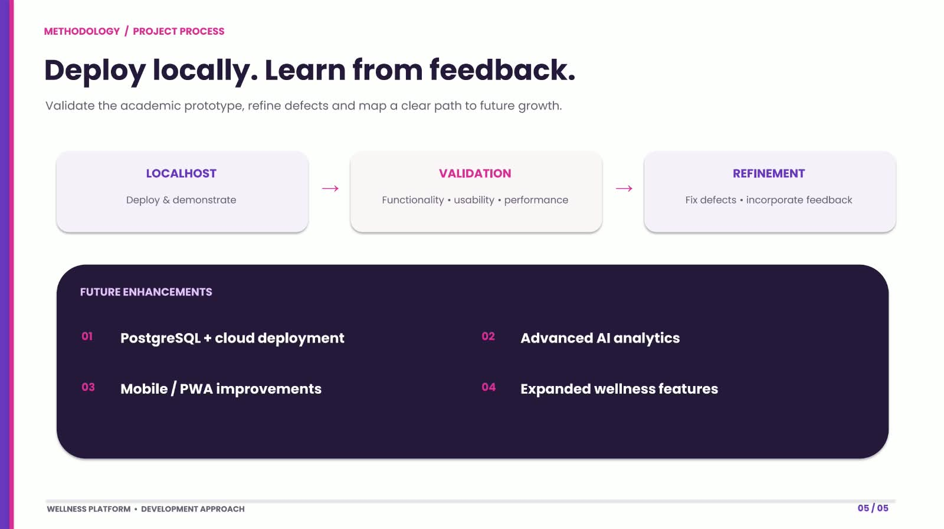

Slide 13
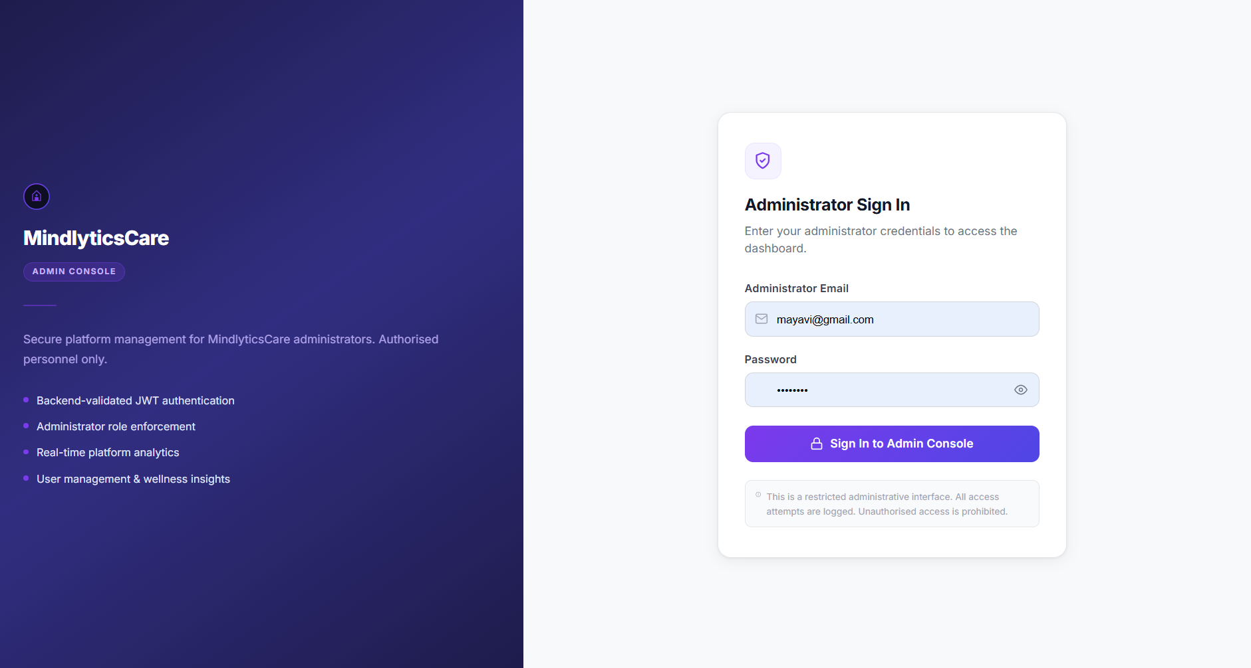

Slide 14
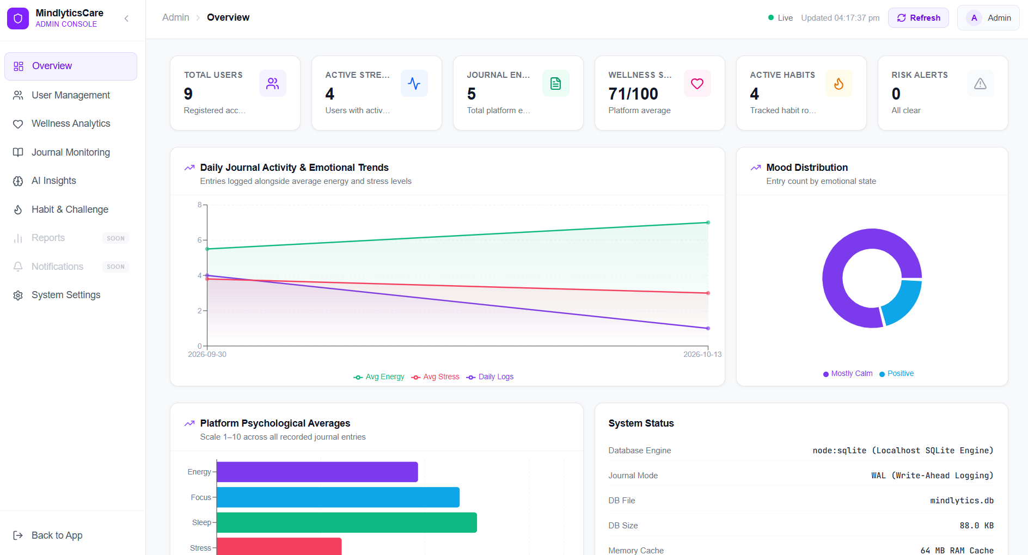

Slide 15
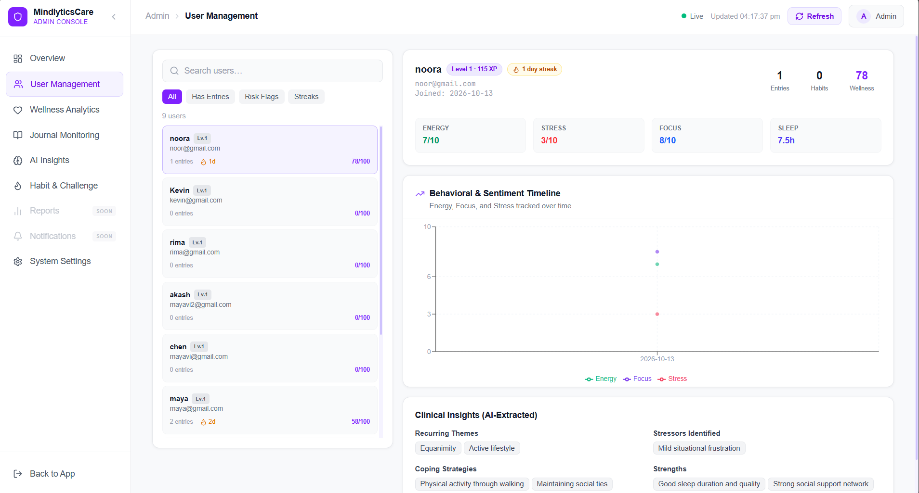

Slide 16
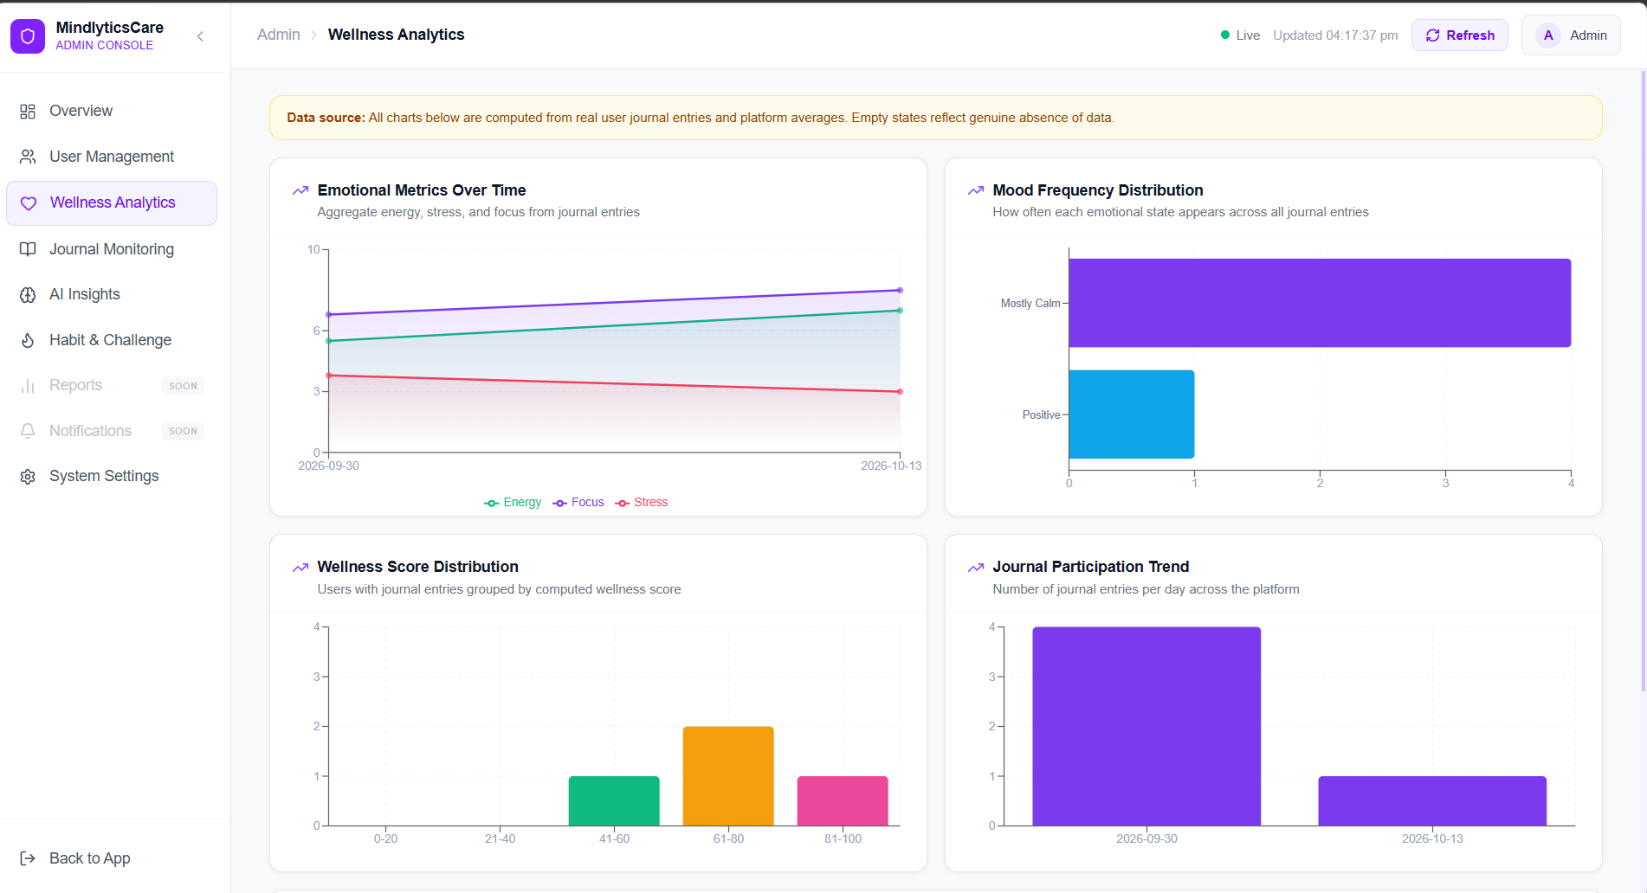

Slide 17
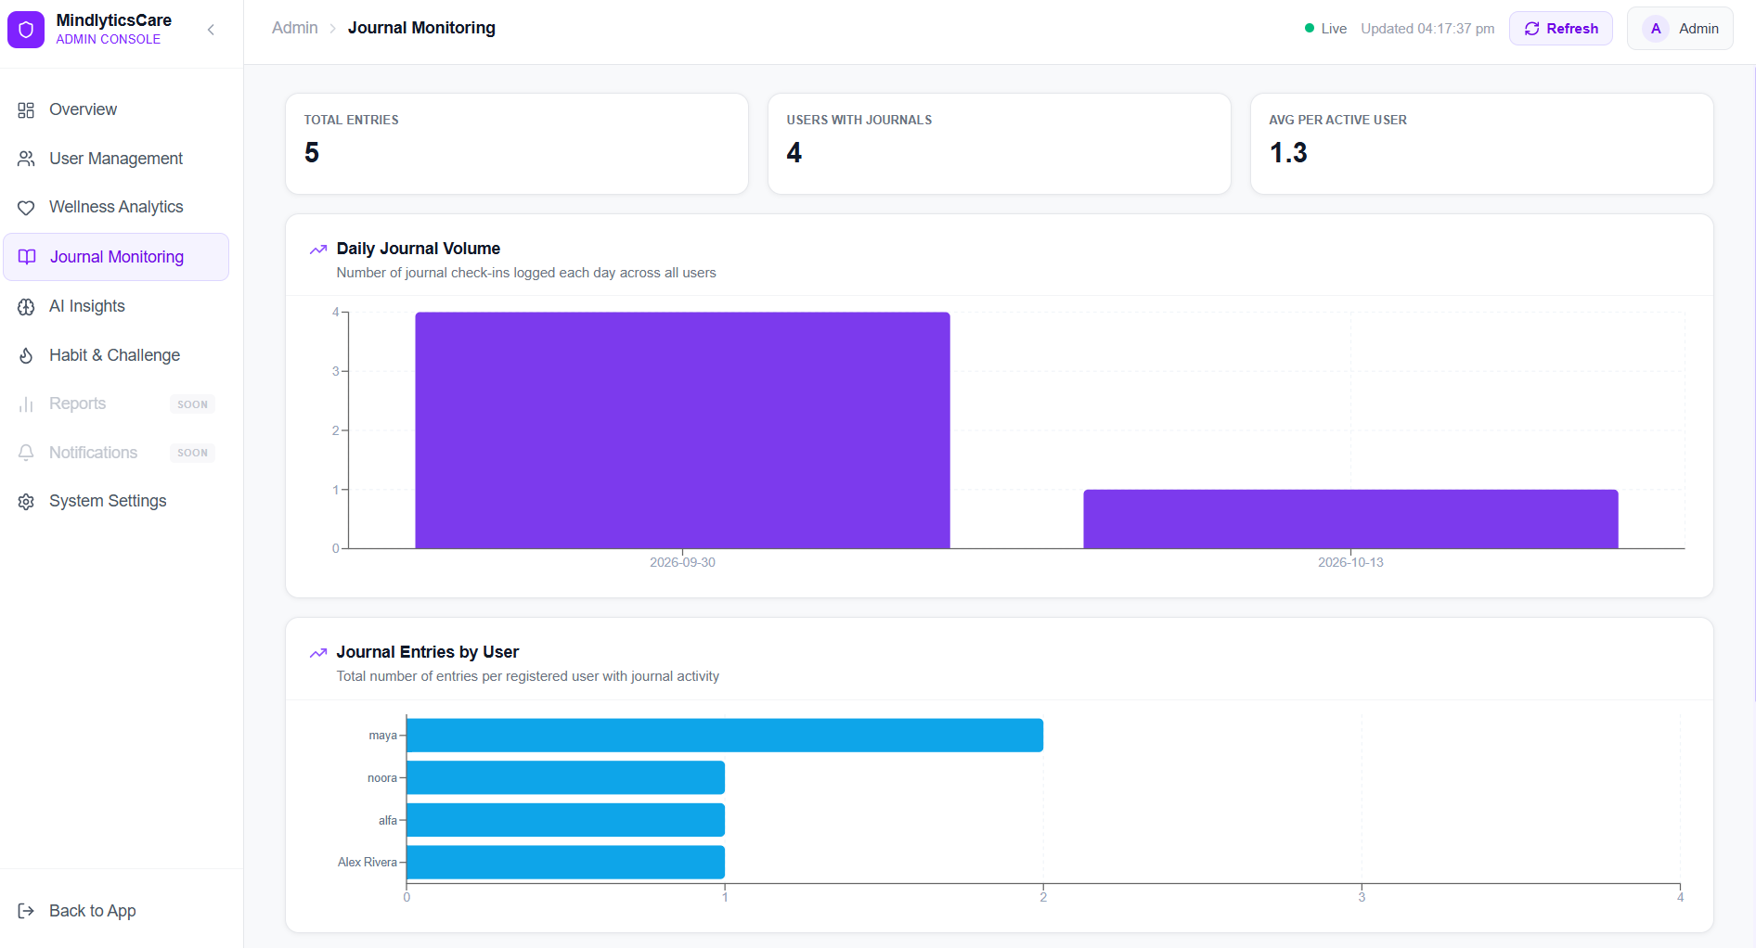

Slide 18
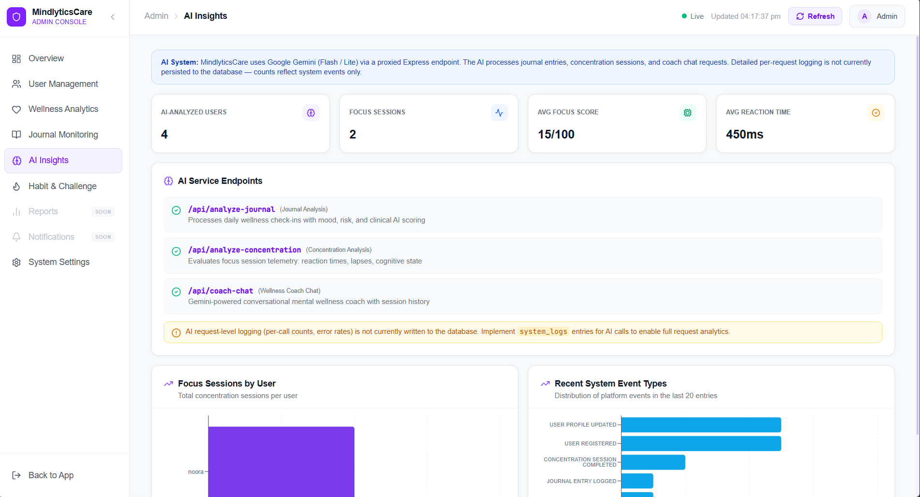

Slide 19
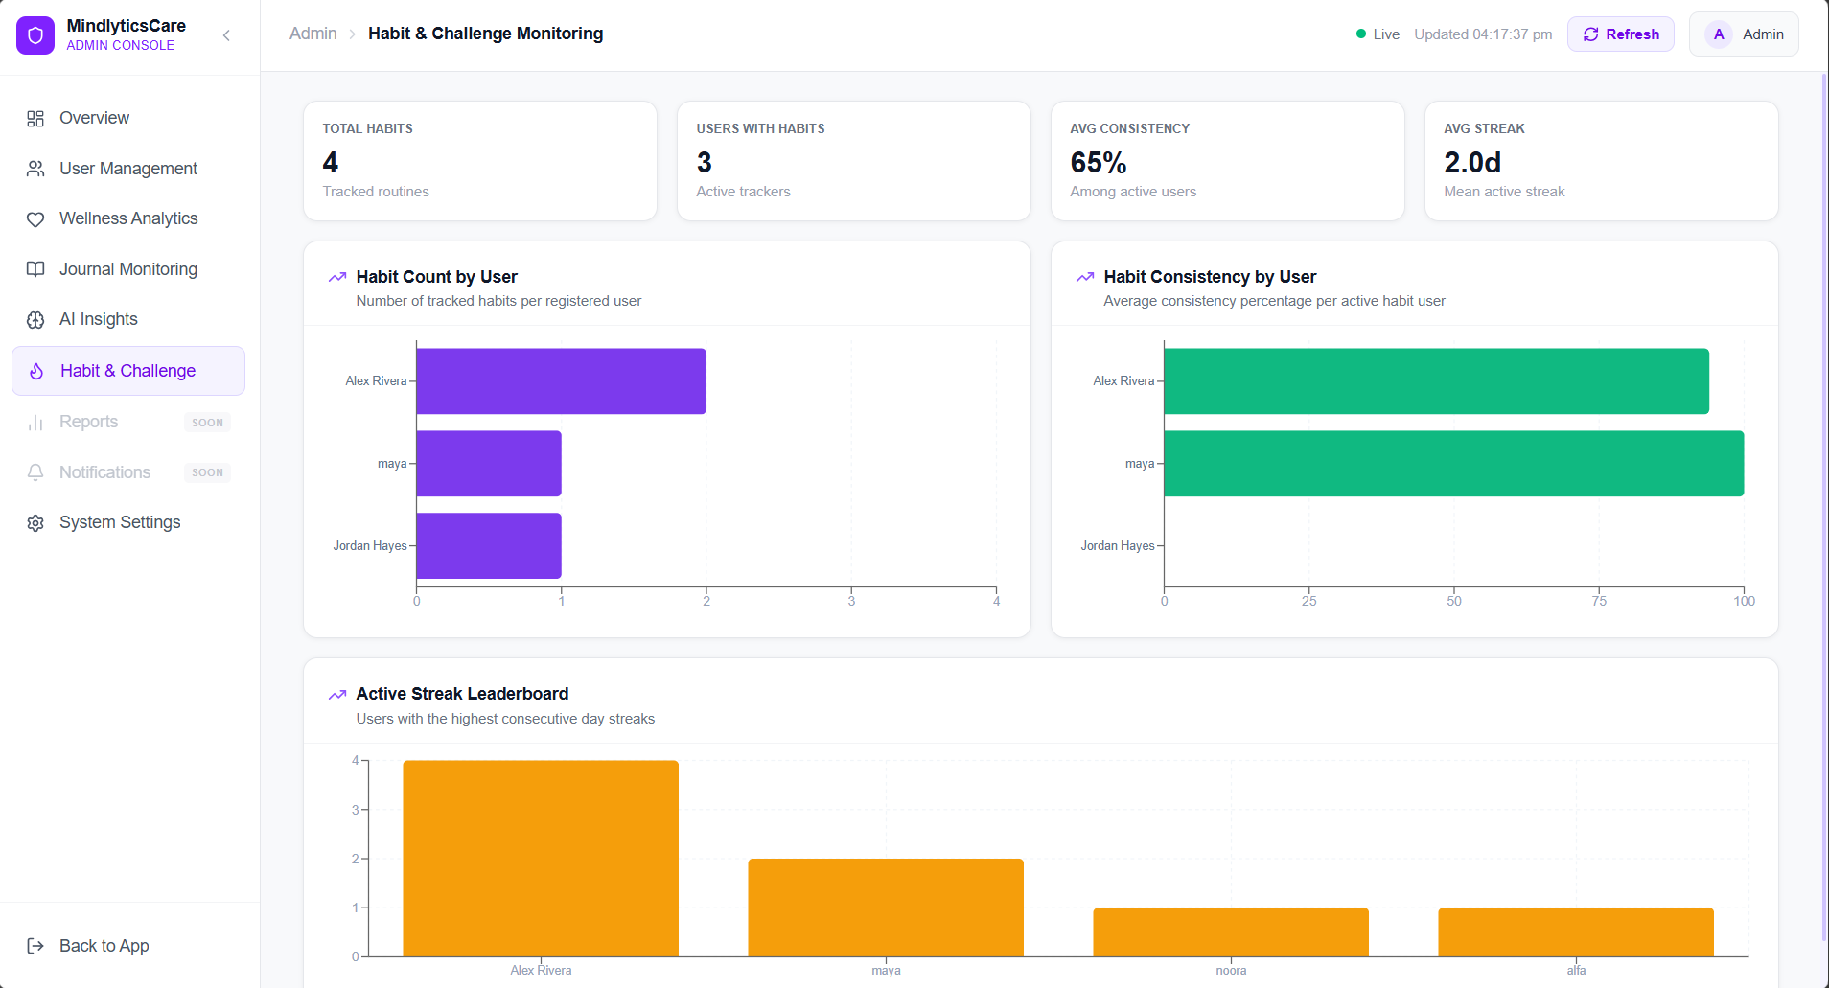

Slide 20
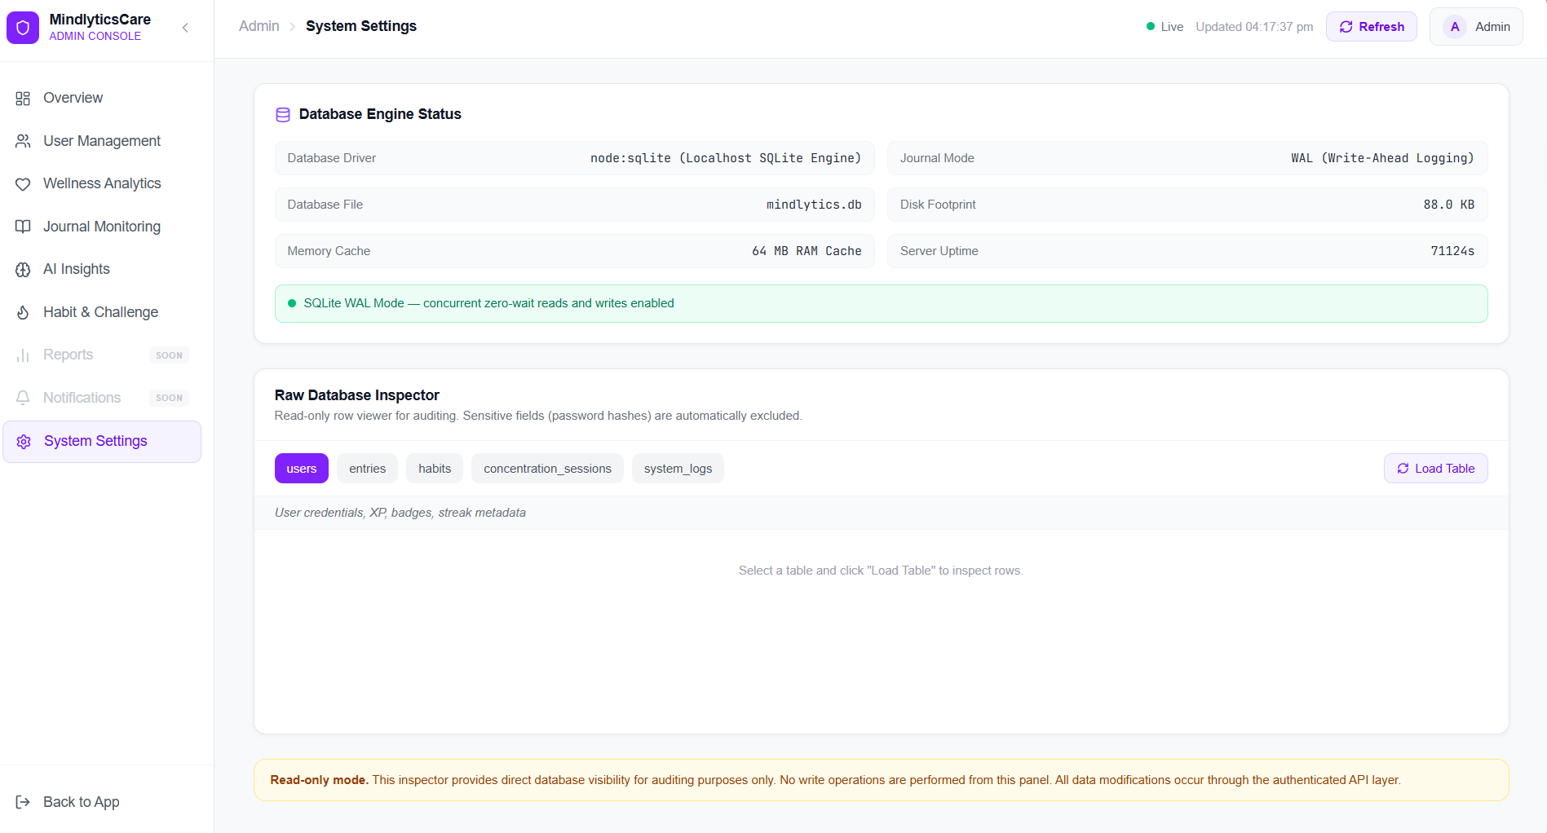

Slide 21
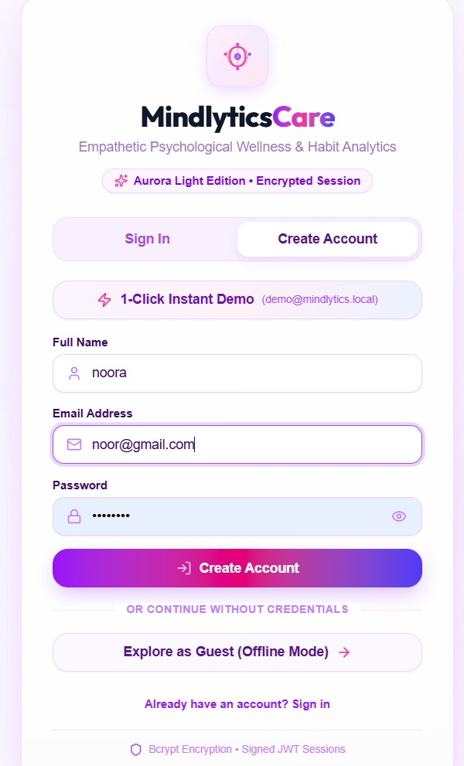
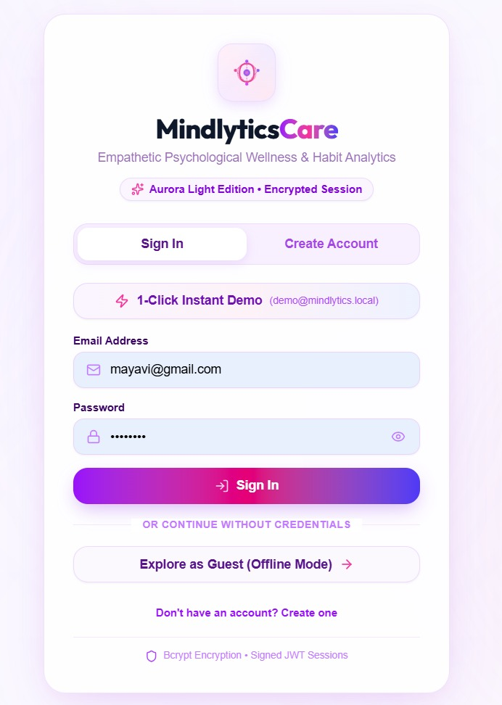
SCREENSHOTS

Slide 22
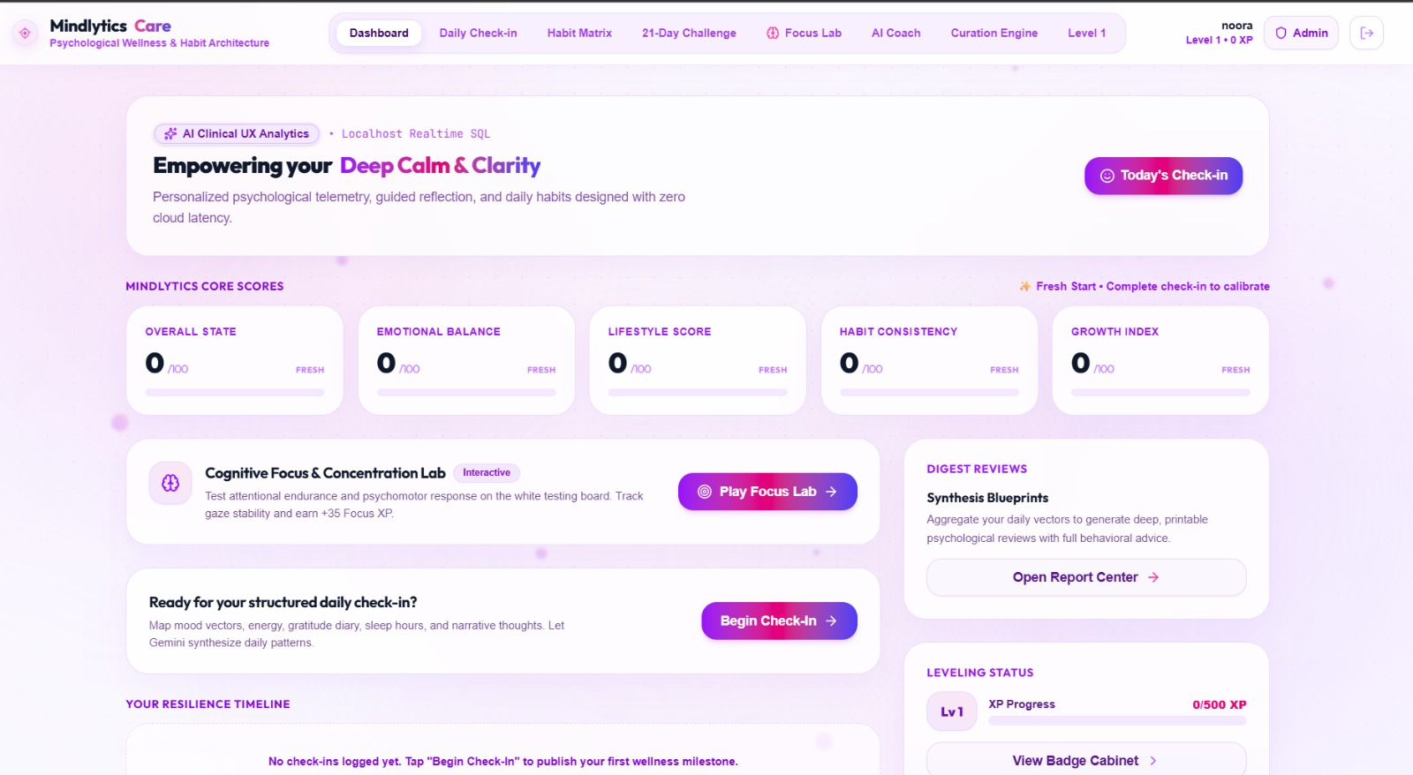

Slide 23
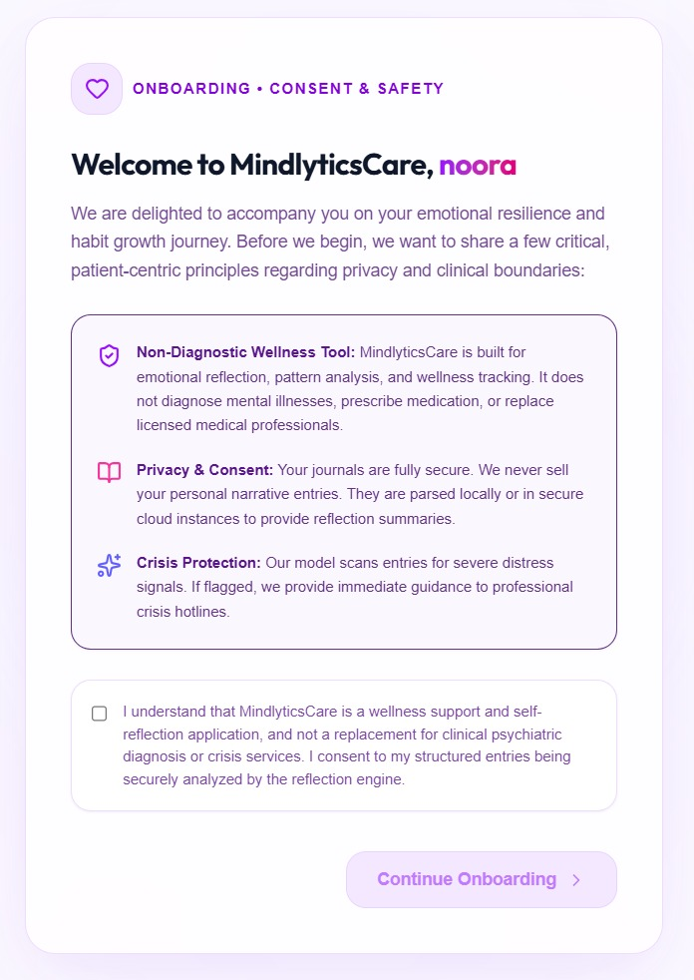
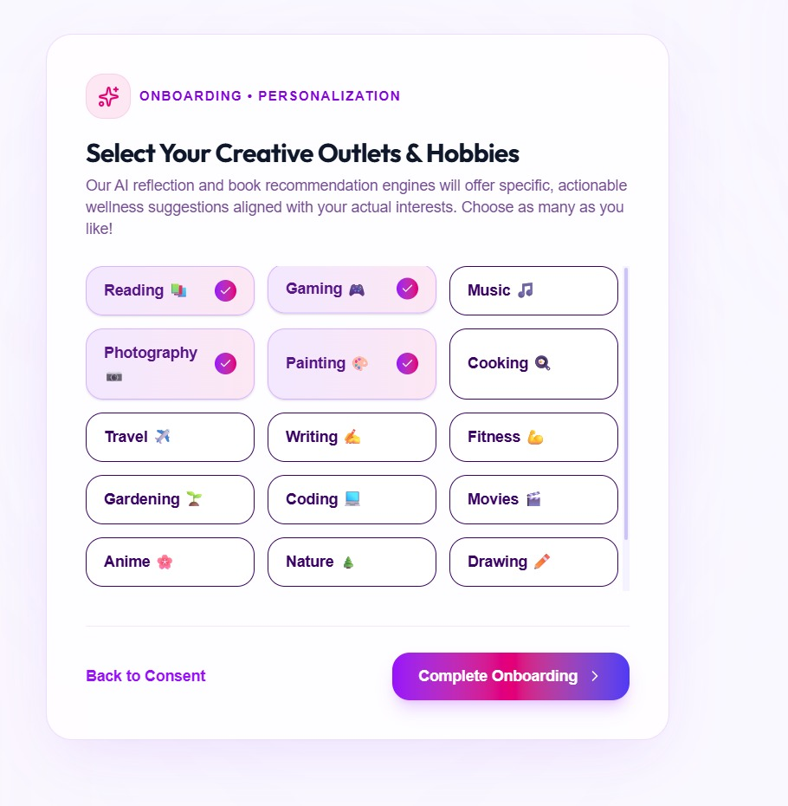

Slide 24
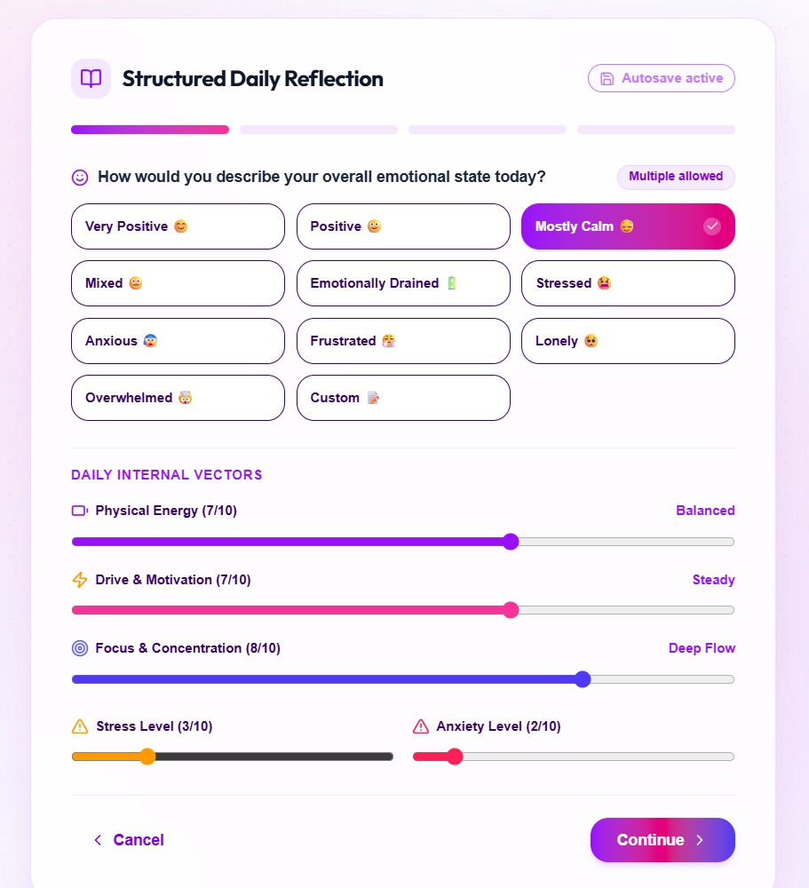
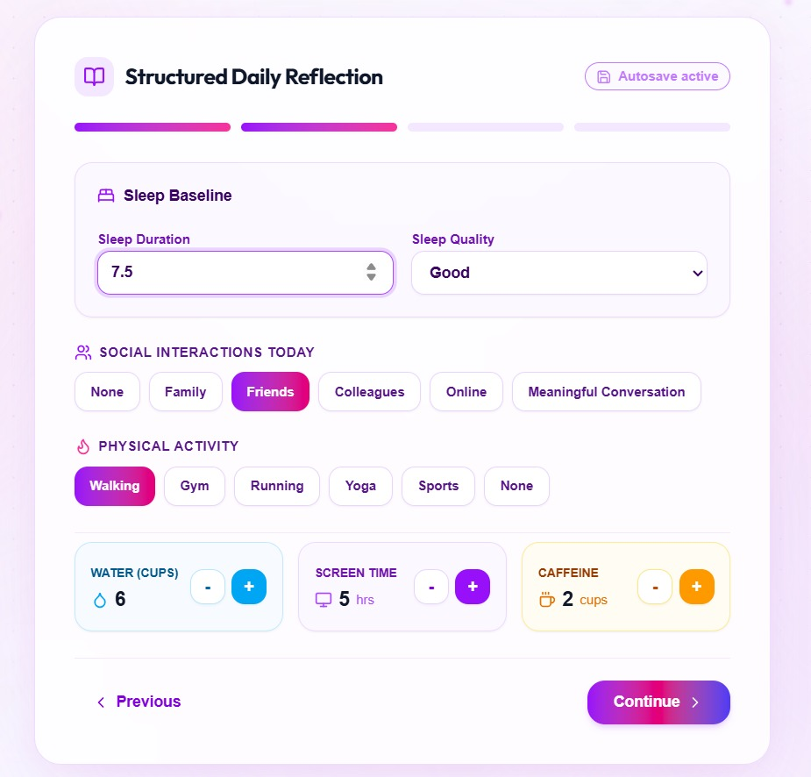

Slide 25
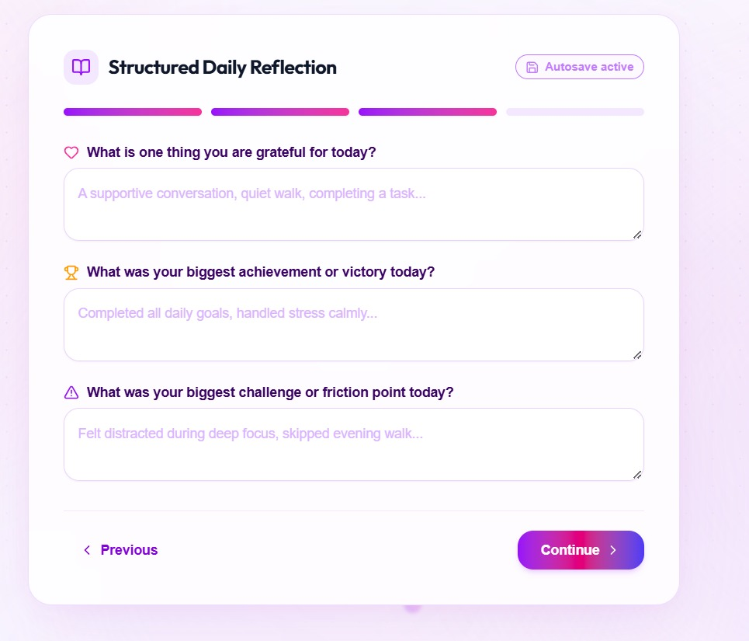
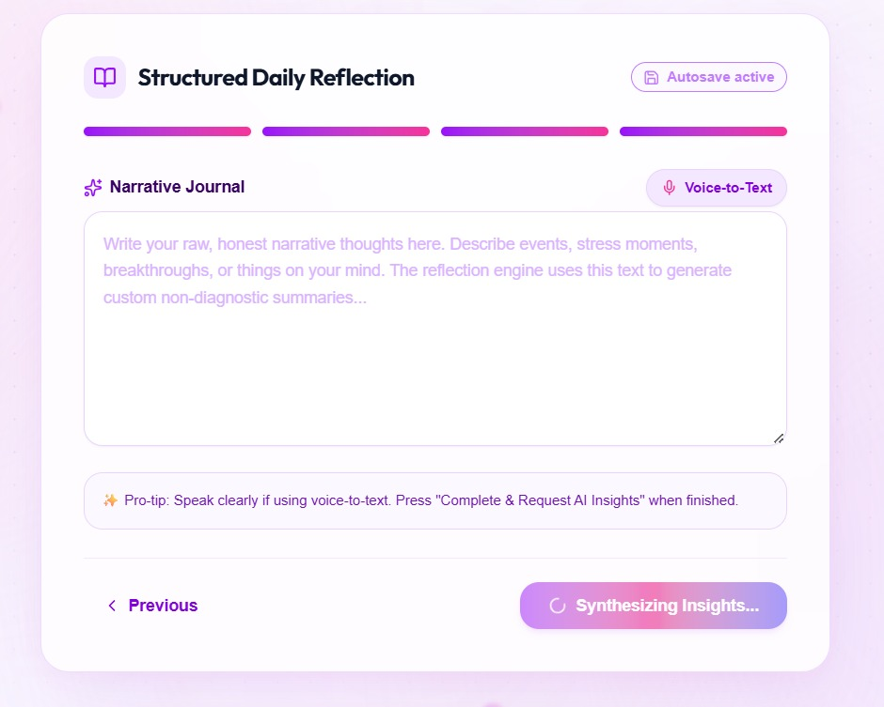

Slide 26
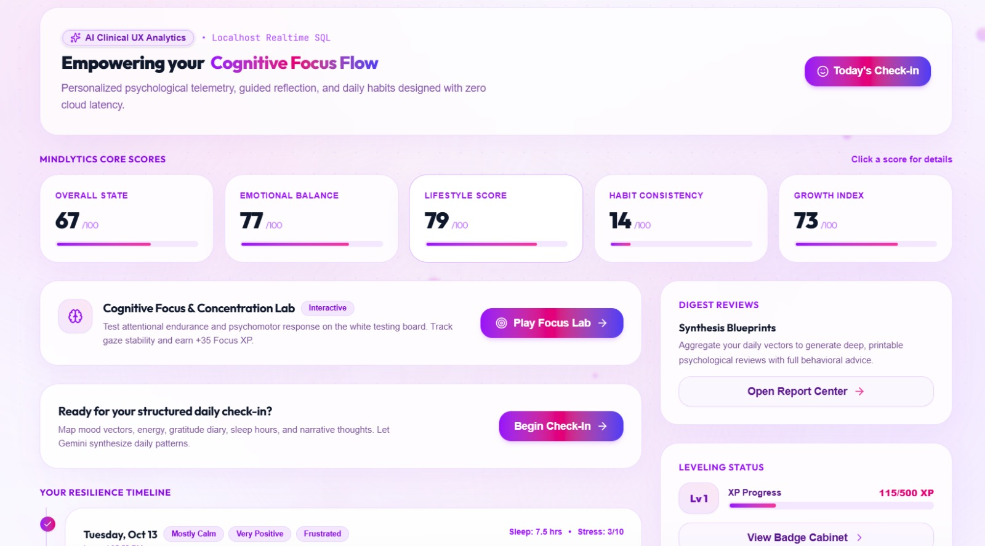

Slide 27
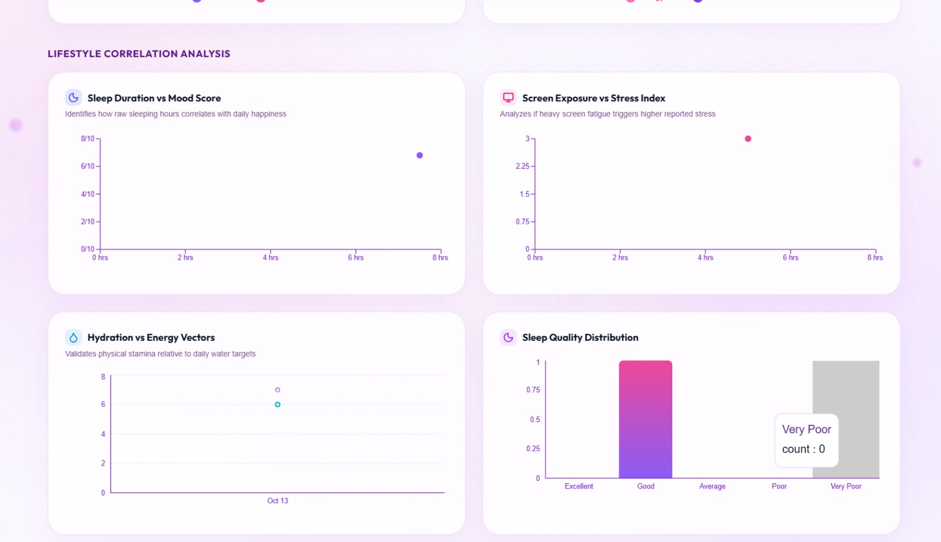

Slide 28
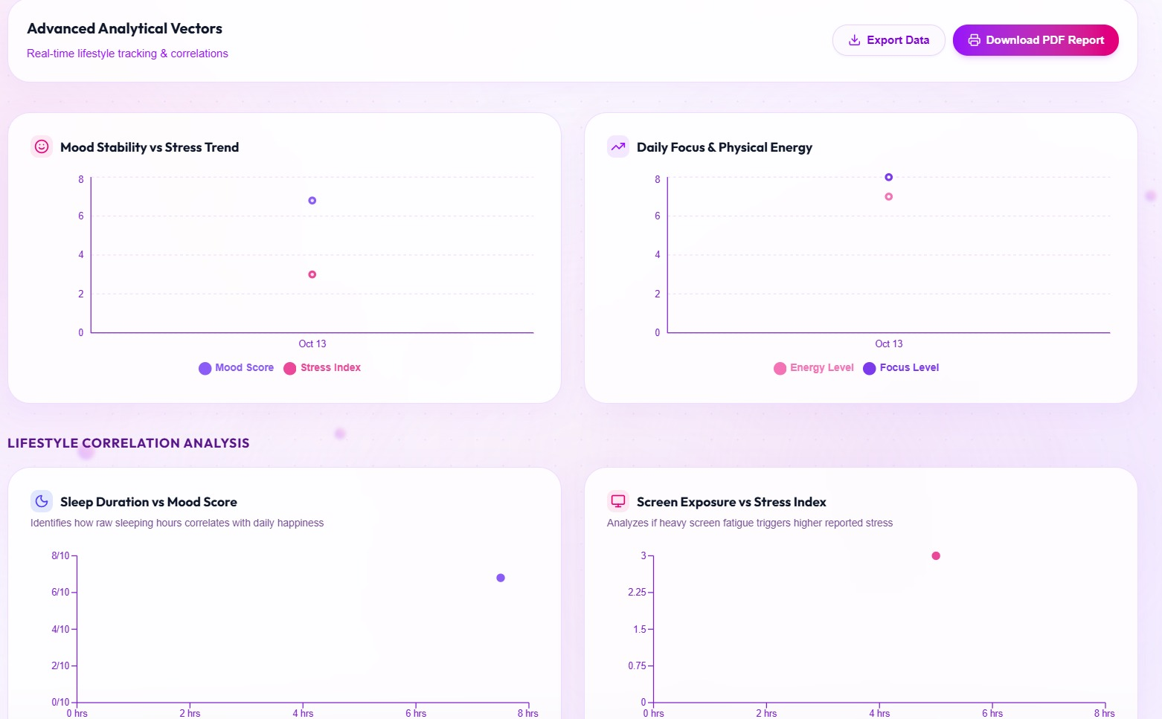

Slide 29
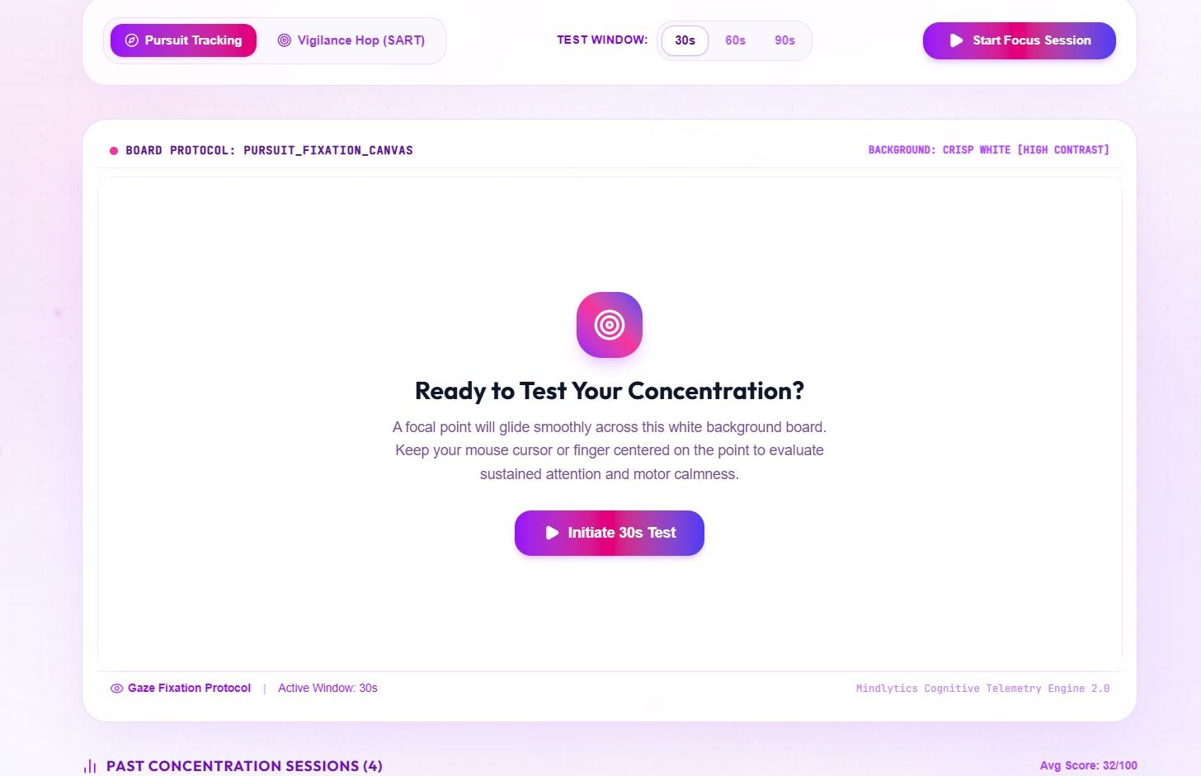

Slide 30
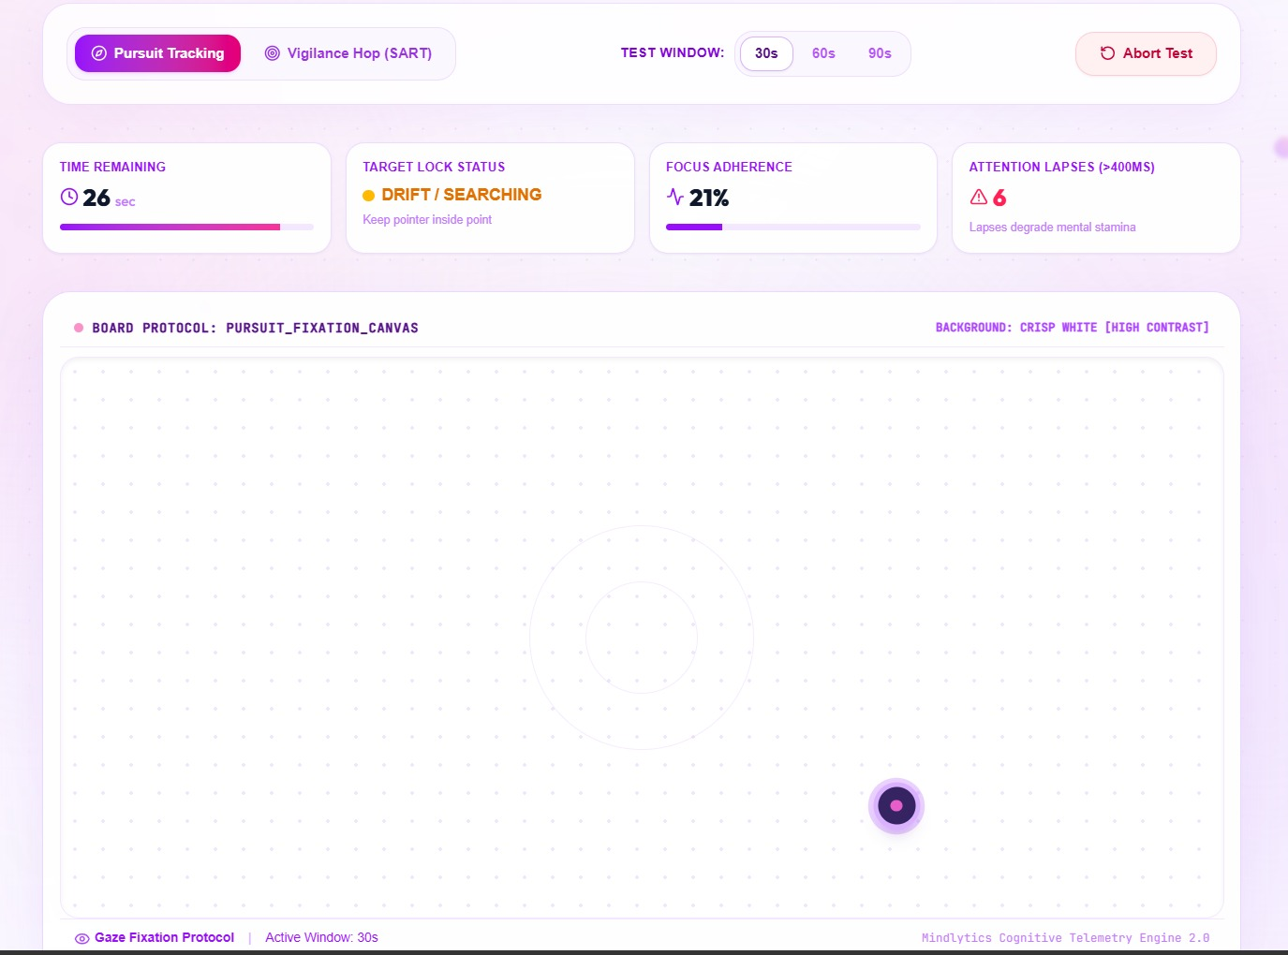
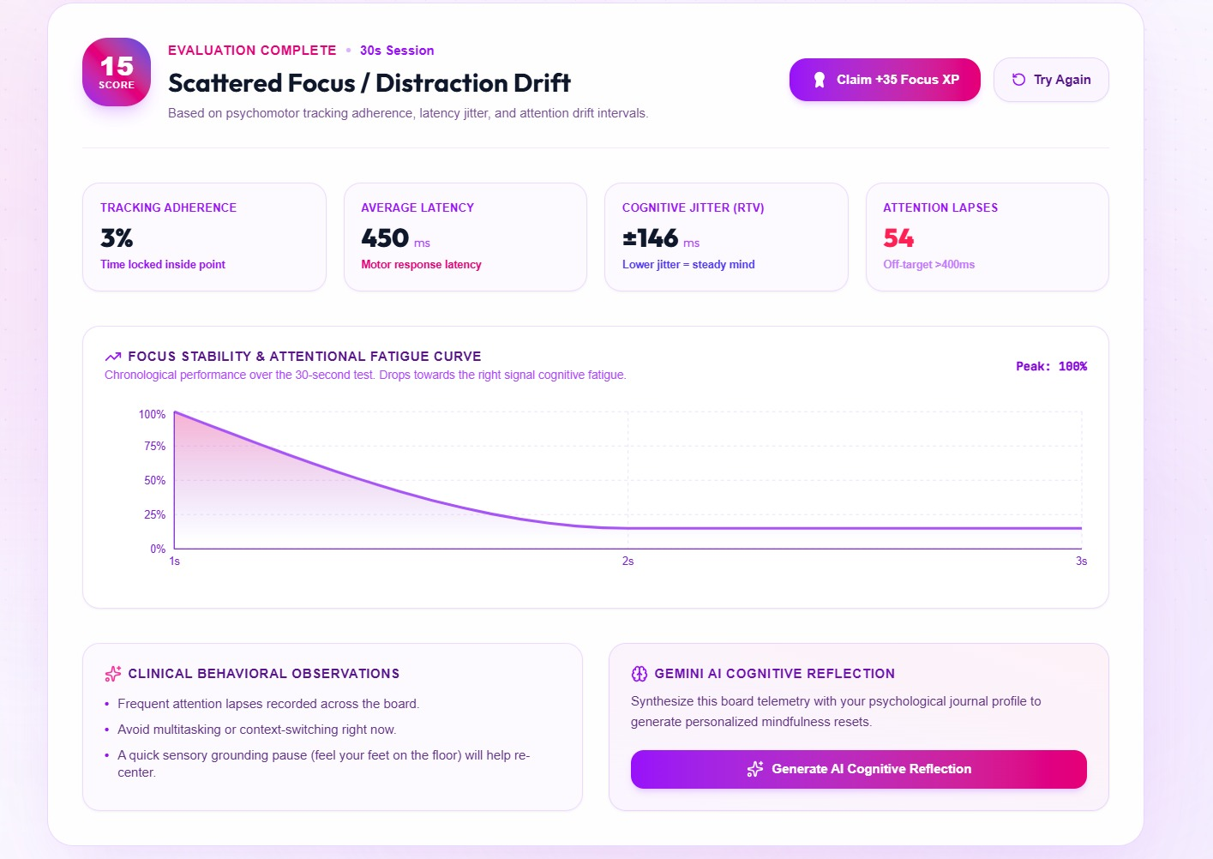

Slide 31
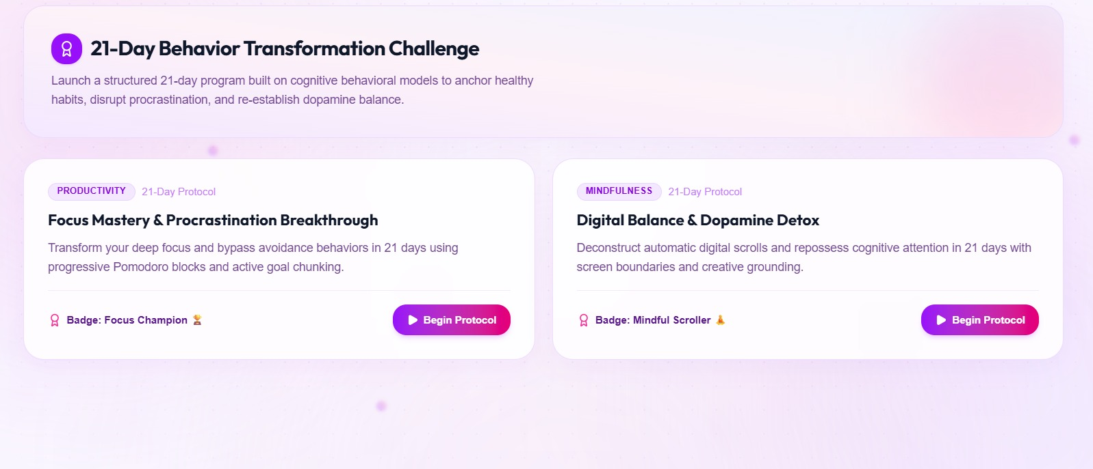

Slide 32
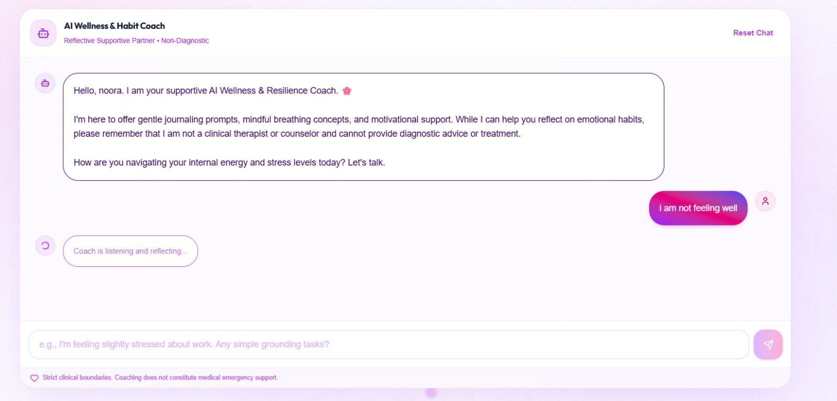

Slide 33
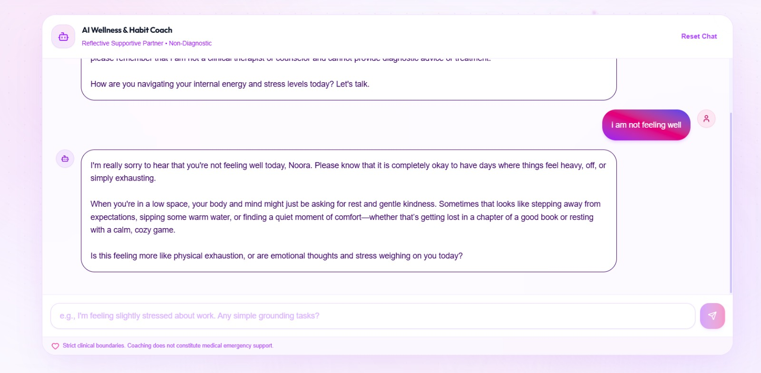

Slide 34
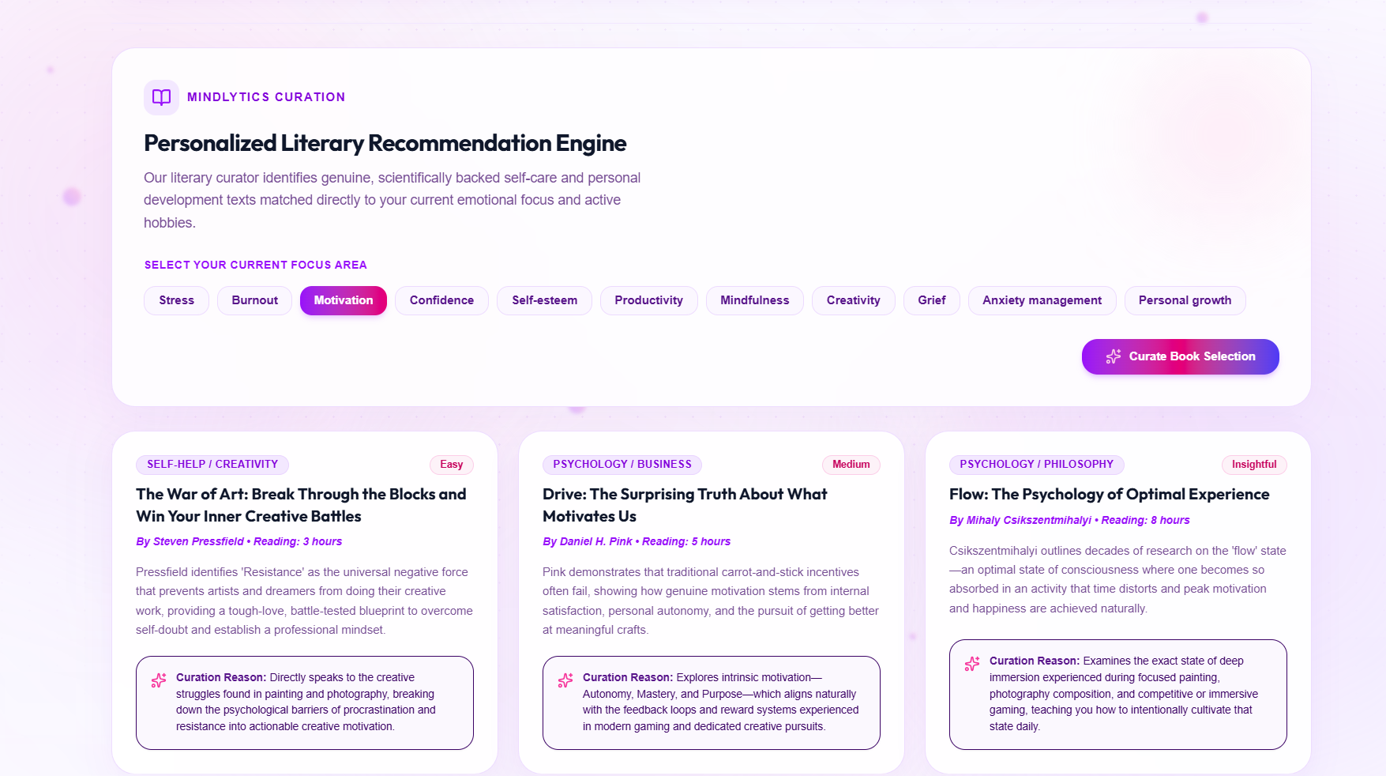

Slide 35
THANK YOU

